Slide 1



SAI VIDYA INSTITUTE OF TECHNOLOGY Approved by AICTE, New Delhi, Affiliated to VTU, Recognized by Govt. of Karnataka, Accredited by NBA, New Delhi (CSE, ECE. ISE) NAAC "A" Grade
DEPARTMENT OF COMPUTER SCIENCE AND ENGINEERING BCS586: MINI PROJECT (TEAM 22)
AI-Driven Decision Support Application for Veterinary Management
PRESENTED BY MAHIMA K (1VA23CS092) NIHARIKA M KODIGE (1VA23CS105) RANJANA H (1VA23CS129) SM PARKAVI (1VA23CS134)
UNDER THE SUPERVISION OF, Dr. VARUN . E , Associate Professor, DEPT., OF CSE., SVIT

Slide 2
OUTLINE
INTRODUCTION ABSTRACT LITERATURE SURVEY PROBLEM STATEMENT OBJECTIVES PROPOSED METHODOLOGY EXPECTED OUTCOMES REFERENCES
DEPARTMENT OF COMPUTER SCIENCE AND ENGINEERING

Slide 3
ABSTRACT
This project presents a smart veterinary management platform that integrates AI to streamline the handling of animal health records. The system combines secure login, QR-based record retrieval, and real-time database updates to ensure efficient and accurate veterinary data management. An AI chatbot further enhances usability by offering instant assistance, enabling veterinarians to provide timely, effective, and data-driven animal care.
DEPARTMENT OF COMPUTER SCIENCE AND ENGINEERING

Slide 4
INTRODUCTION
Introduction – AI-Driven Veterinary Management System Developed an AI-powered veterinary management website to modernize and simplify animal healthcare management. Provides doctor login and allows instant access to animal health records using a unique ID or QR code. Features a centralized database for real-time updates of vaccinations, treatments, and medical histories Includes an AI chatbot assistant to guide doctors. Enhances data accuracy and reduces manual workload, helping veterinarians deliver faster and more reliable care.
DEPARTMENT OF COMPUTER SCIENCE AND ENGINEERING

Slide 5
LITERATURE SURVEY
S.No | Title with Authors Name, Paper Journal name and Year | Methodology/Algorithm/Technology used | Future Work
1. | “Advancements in Immunization Management for Personalized Vaccine Scheduling with IoT and Machine Learning”Dr. M. Madheswaran et al.IEEE ICCSP, 2024 | IoT devices for real-time health data. Decision Tree algorithm for vaccine scheduling. Machine learning for predictive recommendations. | • Use genetic and immune data for predictions. • Apply decentralized digital health records.
2. | “AI Veterinary Assistance: Enhancing Clinical Decision-Making in Animal Healthcare”Youn-Gyu Jin et al.IEEE Access, 2025 | AI Veterinary Assistance (AVA) using GPT-4o LLM. Symptom extraction via in-context learning. Disease prediction using symptom database. | Improve accuracy for varied language input. Develop specialized veterinary LLMs.
3. | “Cloud IoT Based Surveillance System for Tracking and Monitoring of Domestic Animals”Ande NagaSai Manikanta et al.IEEE ICICACS, 2024 | IoT sensors (LM35, MAX30100, GPS) with Arduino. Cloud data storage and GSM alerts. Real-time animal health tracking. | Add advanced ML for pattern analysis. Expand to multiple animal species.
DEPARTMENT OF COMPUTER SCIENCE AND ENGINEERING

Slide 6
LITERATURE SURVEY
S.No | Title with Authors Name, Paper Journal name and Year | Methodology/Algorithm/Technology used | Future Work
4. | AI-Powered Veterinary Chatbot for Automated Diagnosis Prashanna J, Dr. Vanita Jaitly ICICT 2025, IEEE | ML (SVM, Decision Tree) for disease detection NLP + Google API (TTS) for chatbot - Data mining for learning & insights | Expand dataset for better accuracy Add multilingual support - Integrate IoT pet health tracking
5. | Veterinary Medical Records Application using AWS Dr. Deepika Soni et al. ICMCSI 2024, IEEE | AWS 3-tier web architecture EC2, Lambda, S3, RDS, CloudFront Serverless backend with API Gateway | Add mobile app features Include IoT/microchip data Improve interface usability
6. | Web-Based Veterinary Clinic with e-Mail and SMS Notification Samuel S. Chua et al. ICBIR 2024, IEEE | Web app using PHP, MySQL, XAMPP Waterfall SDLC model Auto e-mail & SMS alerts | Enhance site security Add AI for reminders Support image attachments
DEPARTMENT OF COMPUTER SCIENCE AND ENGINEERING

Slide 7
PROBLEM STATEMENT
To Design and Implement an intelligent veterinary management system that leverages Artificial Intelligence and data-driven decision-making to streamline medical record management, support accurate health monitoring, and enable timely interventions for animals.
DEPARTMENT OF COMPUTER SCIENCE AND ENGINEERING

Slide 8
OBJECTIVES
1. Create a user-friendly and responsive platform that works seamlessly across devices, making it easy for veterinarians to manage health records. 2. Build a secure and efficient backend database system to store, update, and retrieve veterinary medical data quickly and reliably. 3. Develop and integrate AI tools that analyze animal health data to support smarter decisions in diagnosis, treatment, and prevention while continuously improving the system through real-time testing and expert feedback.
DEPARTMENT OF COMPUTER SCIENCE AND ENGINEERING

Slide 9
PROPOSED METHODOLOGY
In the application, veterinary doctors serve as the main users, while the AI assistant functions as a supportive tool to assist in diagnosis. Design a structured database with tables for animals, and their health history to ensure easy retrieval of data. Develop core modules including: Doctor Module - for login. Animal Module - to assign unique IDs and QR codes for each animal. Health Record Module - for managing vaccination history, symptoms, and treatments. AI and Decision Support Integration Implement rule-based AI algorithms to analyze symptoms, suggest probable diagnoses, and guide basic remedies. Notifications and Monitoring Enable real-time notifications for doctor availability, clinic hours, ambulance numbers, and important updates like upcoming holidays or vaccination reminders.
DEPARTMENT OF COMPUTER SCIENCE AND ENGINEERING- ARTIFICIAL INTELLIGENCE & MACHINE LEARNING

Slide 10
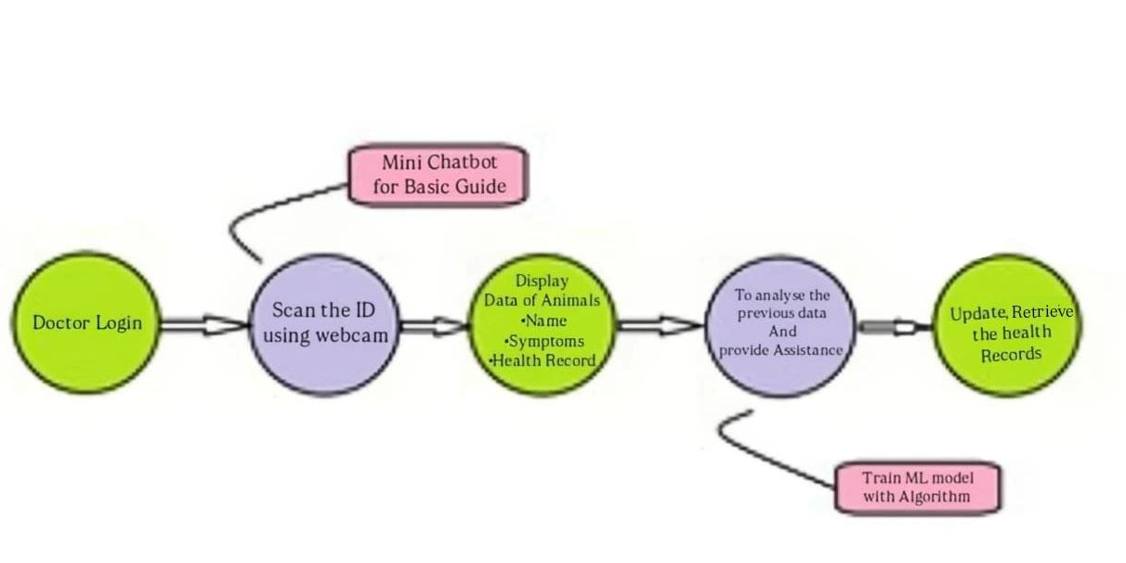
PROPOSED METHODOLOGY
DEPARTMENT OF COMPUTER SCIENCE AND ENGINEERING

Slide 11
TECHNOLOGY USED
Python (Open Source): Core backend programming language for logic handling and future AI model integration. Flask Framework (Open Source): Lightweight web framework to manage routes, APIs, and backend communication. SQLite with SQLAlchemy (Open Source): Handles structured data storage and ORM-based database interactions. HTML, CSS, and Jinja2 (Open Source): Used for creating responsive frontend interfaces and dynamic rendering.
DEPARTMENT OF COMPUTER SCIENCE AND ENGINEERING

Slide 12
SYSTEM ARCHEITECTURE
Frontend Layer: Built using HTML/CSS and rendered via Jinja2; enables veterinarians to input animal symptoms and view diagnostic outputs. 2. Application Layer: Flask acts as the central controller, processing user input, managing sessions, and executing AI/ML logic. 3. Database Layer: SQLite/PostgreSQL stores animal records, doctor credentials, and medical histories securely. 4. Development Environment: Implemented using VS Code IDE (Open Source) for code development, testing, and version control integration.
DEPARTMENT OF COMPUTER SCIENCE AND ENGINEERING

Slide 13
EXPECTED OUTCOMES
1. The system provides secure doctor login and QR-based animal identification, allowing doctors to quickly find animal records. It helps avoid duplicate entries, keeps data accurate, and updates records instantly in the database. 2. The built-in AI system helps doctors by suggesting treatments, vaccination schedules, and diagnoses based on stored health data. This reduces manual work and supports better and faster decision-making. 3. With automation and real-time record tracking, the platform makes veterinary work easier, saves time, and ensures better care and management for animals.
DEPARTMENT OF COMPUTER SCIENCE AND ENGINEERING

Slide 14
REFERENCES
[1] Prashanna J and Dr. Vanita Jaitly, “AI-Powered Veterinary Chatbot for Automated Diagnosis,” Proceedings of the International Conference on Inventive Computation Technologies (ICICT), pp. 1629–1635, Jan. 2025. [2] Dr. Deepika Soni, Dr. Awanit Kumar, Dr. Vikas Somani, and Dr. Sheshang Degadwala, “Veterinary Medical Records Application using AWS,” 5th International Conference on Mobile Computing and Sustainable Informatics (ICMCSI), pp. 578–583, Feb. 2024. [3] Samuel S. Chua, Jolina A. Alis, and Mary Joelyn Oria, “Web-Based Veterinary Clinic with e-Mail and SMS Notification,” 9th International Conference on Business and Industrial Research (ICBIR), pp. 1160–1165, May 2024. [4] M. Madheswaran, S. Aghalya, R. Dhanalakshmi, S. Raju, G. Ramasubramanian, and P. Thirumaraiselvan, “Advancements in Immunization Management for Personalized Vaccine Scheduling with IoT and Machine Learning,” 10th International Conference on Communication and Signal Processing (ICCSP), pp. 1566–1570, April 2024. [5] Y.-G. Jin, G. Wu, J.-W. Seo, S.-J. Park, S.-H. Hur, D. Aliyeva, J.-H. Park, and K.-M. Kim, “AI Veterinary Assistance: Enhancing Clinical Decision-Making in Animal Healthcare,” IEEE Access, vol. 13, pp. 119292–119299, July 2025. [6] A. N. Manikanta, A. F. Baba, D. S. Vyshnavi, D. K. Paul, and S. S. Sreedhar, “Cloud IoT Based Surveillance System for Tracking and Monitoring of Domestic Animals,” International Conference on Integrated Circuits and Communication Systems (ICICACS), pp. 1–6, December 2024.
DEPARTMENT OF COMPUTER SCIENCE AND ENGINEERING

Slide 15
SAI VIDYA INSTITUTE OF TECHNOLOGY Approved by AICTE, New Delhi, Affiliated to VTU, Recognized by Govt. of Karnataka, Accredited by NBA, New Delhi (CSE, ECE. ISE) NAAC "A" Grade
THANK YOU
DEPARTMENT OF COMPUTER SCIENCE AND ENGINEERING

